Slide 1
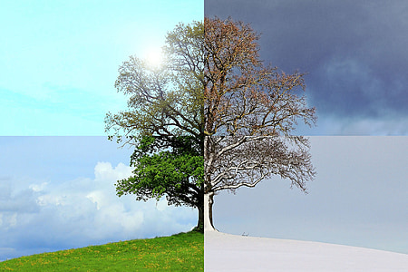
“The Seasons”
-Samuel K

Slide 2
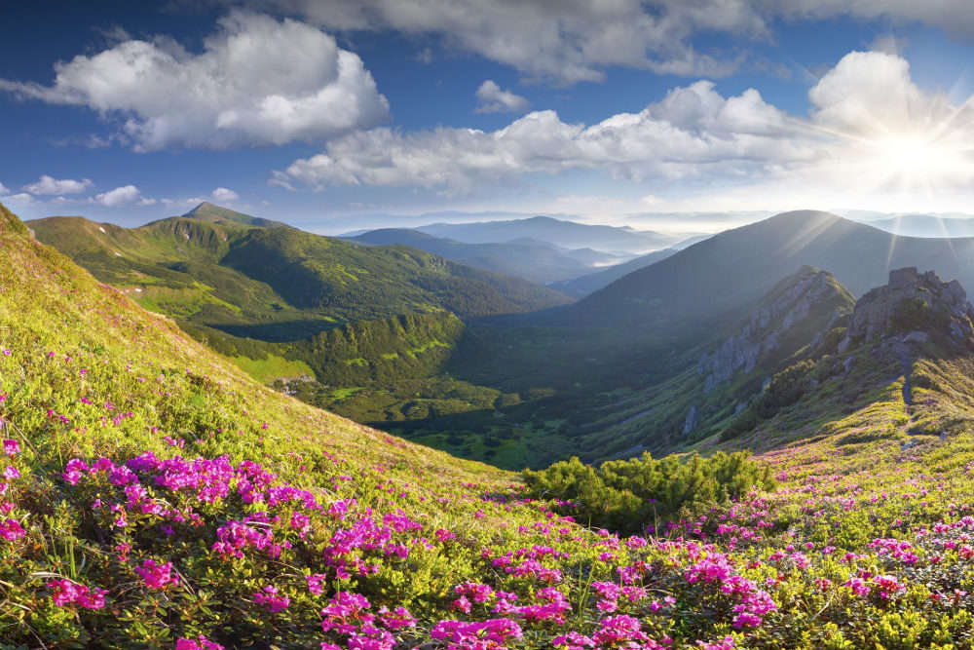
Spring
March 20th is the first day of Spring
Spring lasts from March to June
Observed holidays during this season are Easter, Mother’s and Father’s Day

Slide 3
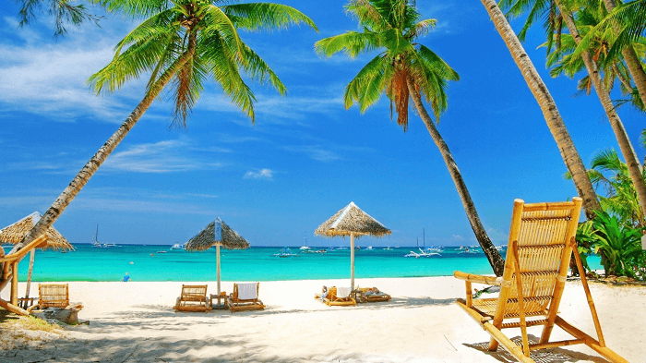
Summer
June 20th is the first day of Summer
Summer lasts from June to September
Observed holidays during this season are Independence Day and Labor Day

Slide 4
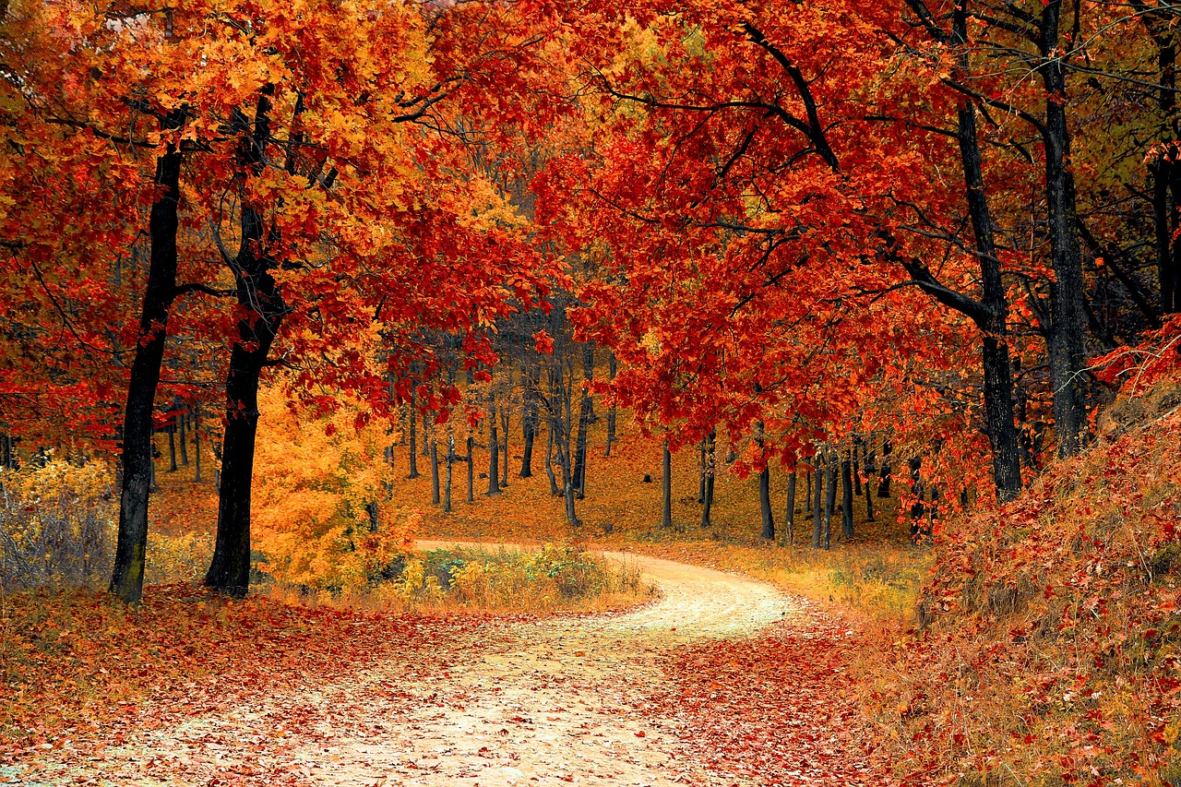
Autumn
September 22nd is the first day of Autumn
Autumn lasts from September to December
Observed holidays during this season are Veteran’s Day, Election Day

Slide 5

Winter
December 21st is the first day of Winter
Winter lasts from December to March
Observed holidays during this season are Christmas, New Year’s, Valentine’s and St. Patrick’s Day

